Slide 1
RECSYS CHALLENGE 2017
Capstone Project
UB Data Science postgraduate 2017
Amadeo Irigoyen, Bet Herrera, Jaume Espriu, Bartolomé Martínez

Slide 2
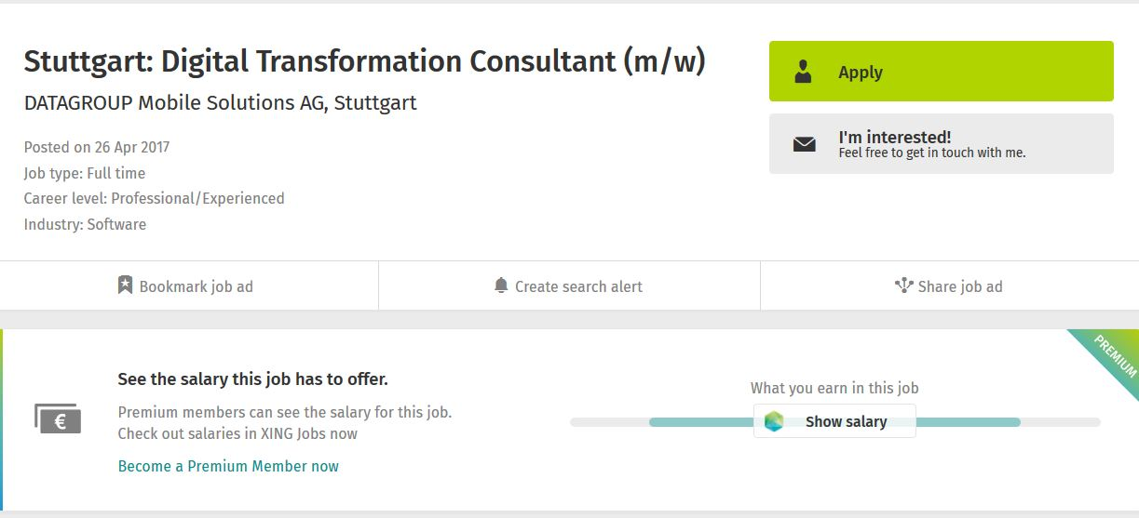
RecSys Challenge Introduction Data & objective
Given a new job posting, identify the XING users that:
Will be interested in receiving the post as a notification
Will be good candidates for the job
USERS
Id
Career level
Discipline & industry id
Country & region
Experience
Edu degree & field of studies
Wtcj
Premium
Job roles
ITEMS / JOBS
Id
Career level
Discipline & industry id
Country & region
Lat & lon
Is_payed
employment
Created_at
Title & tags
INTERACTIONS
0: impression (showed)
1: user click job offer
2: user bookmarked job offer
3: user replied to job offer
4: user deleted job offer
5: Recruiter contacted user for the job

Slide 3
RecSys Challenge Introduction Score criteria & challenges
Challenges |  | 325 millions of interactions Around 1,5 million of users Around 1,3 million of items Challenge targets a small subset of users & items to predict over them All items cold Around 40% users cold Presence of NAs Terms-based features |  | Score criteria |  | userSucess(item, user) + itemSucess(item, user) Constraint: only 100 users allowed per item
S
userSucess(item, user)=
(+1 per clik
+5 per bookmark or reply
+20 per recruiter interested
-10 per only-delete) * premium boost
itemSucess(item, user)=
+ 50 per payed items
+25 altres

Slide 4
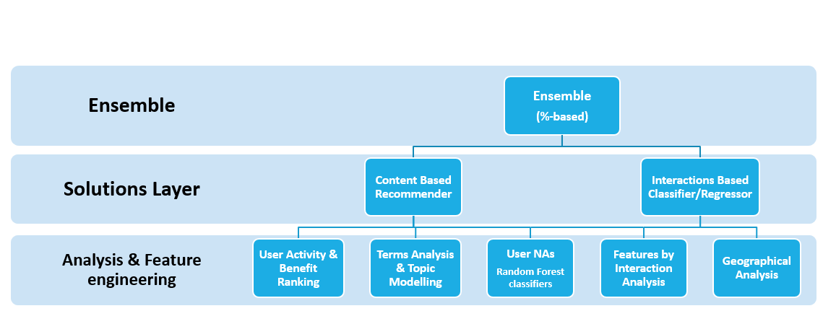
RecSys Solution Summary Overall solution path to the challenge

Slide 5
Extraction and Feature Analysis Features exploration
Features by Interaction Analysis
Differences in users & items by interaction type
Link notebook recruiters & others
Some conclusions:
career level matches or career level +- 1, career level >=4
discipline matches
discipline = 1, 2, 7, 17
industry = 16, 9, 18
experience_n_entries_class = 3
experience_years_experience >= 4
experience_years_in_current<=2
experience_years_in_current>=5
edu_fieldofstudy contains 8
...
Years in job | % of recruited | % others
0 | 5.4 | 18.5
1 | 33.3 | 13.3
2 | 41.9 | 25.0
3 | 7.1 | 14.0
4 | 8.0 | 16.8
5 | 3.7 | 6.0
6 | 0.4 | 3.6
7 | 0.04 | 2.6

Slide 6
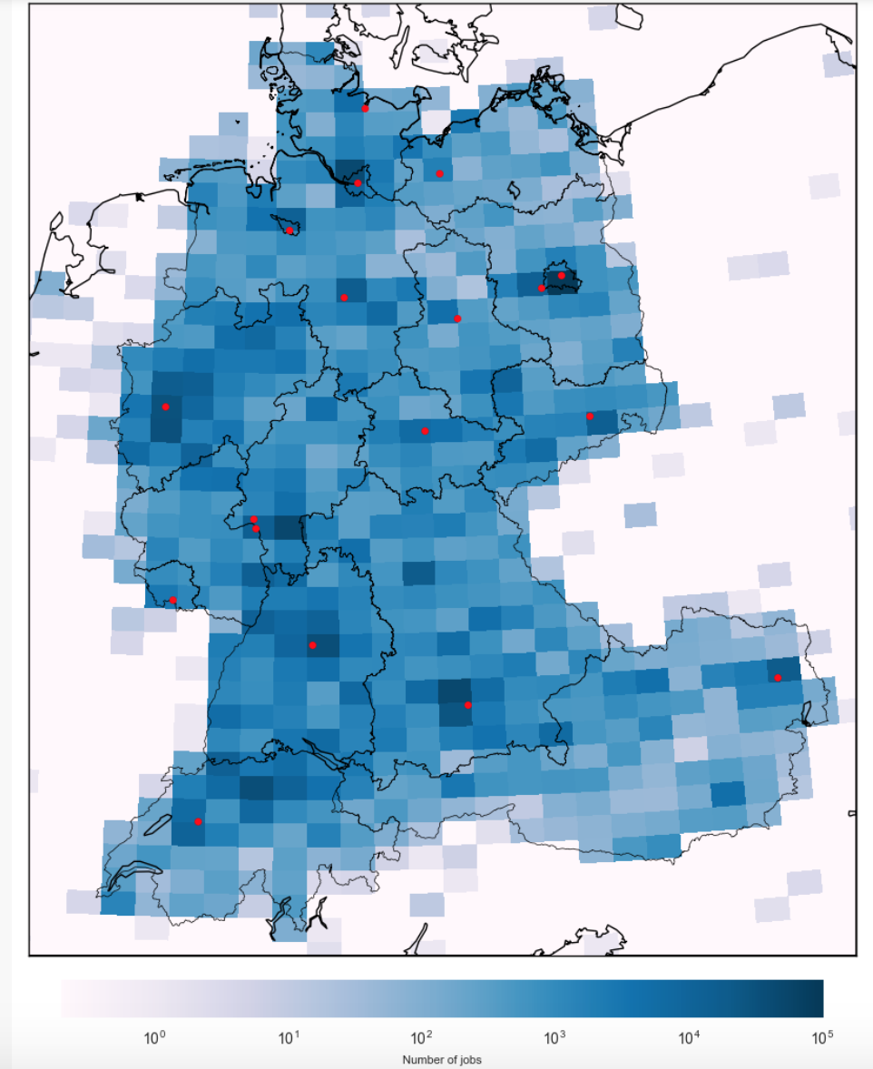
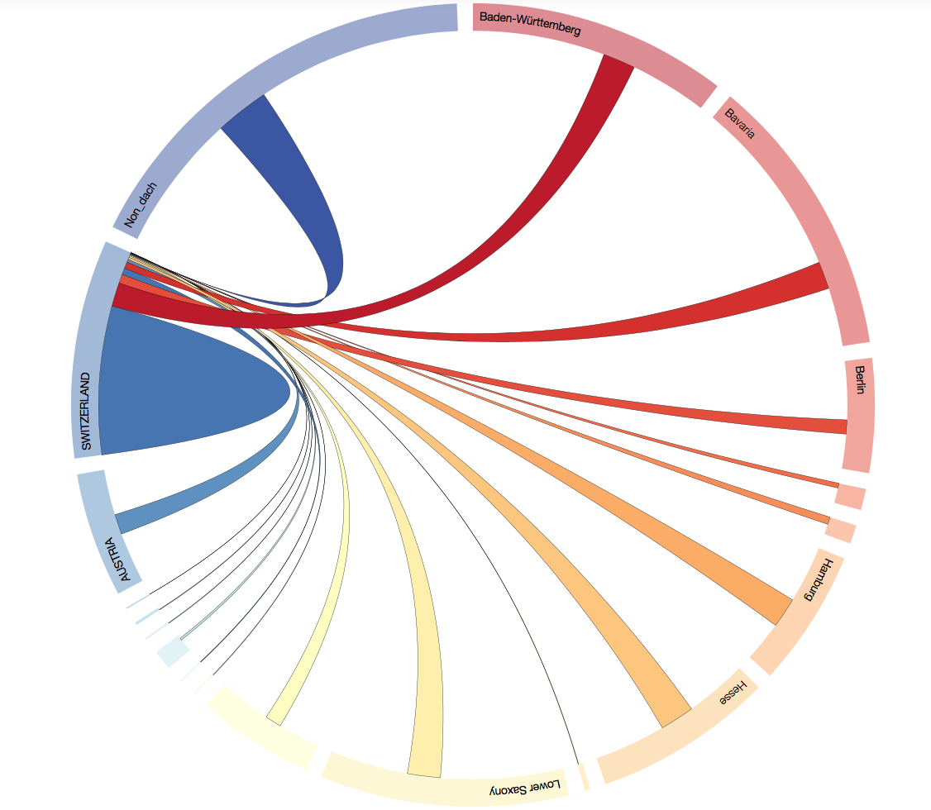
Extraction and Feature Analysis Visualization
Geographical Analysis
Link notebooks

Slide 7
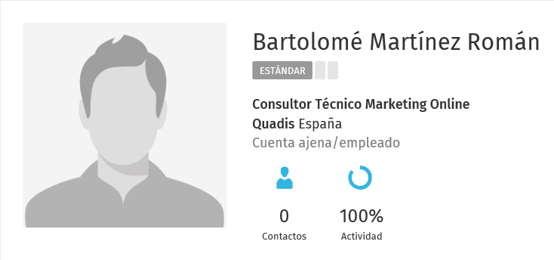

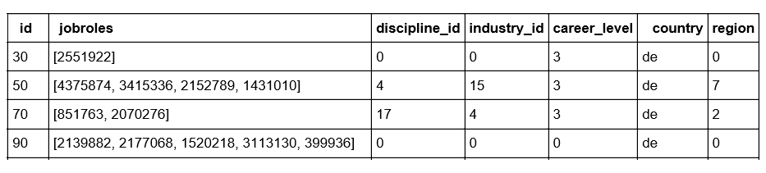
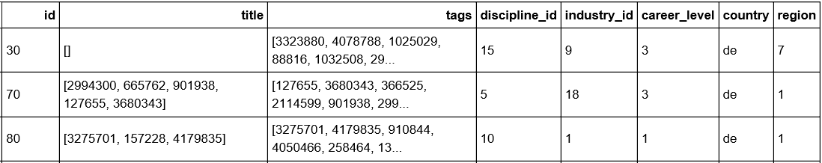
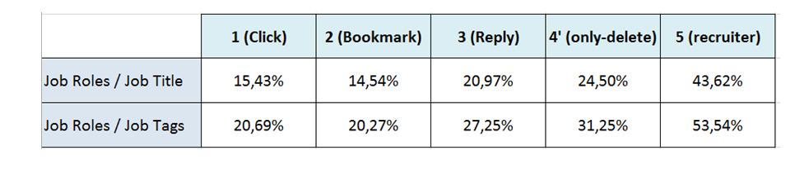
RecSys Challenge Exploratory Analisys Terms Analysis & Topic Modelling (I)
Terms Analysis & Topic Modelling
User’s “Job Roles” Terms
Job Item’s “Title” & “Tags” Terms
Positive Interactions on minimum BoW intersections
No clear correlation between item/user terms terms as-is on most positive interactions (Interests? Curiosity? Polisemia?)
No clear that this can express people willing to change area of work

Slide 8
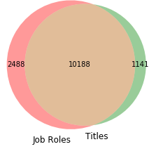
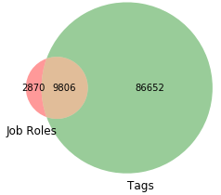
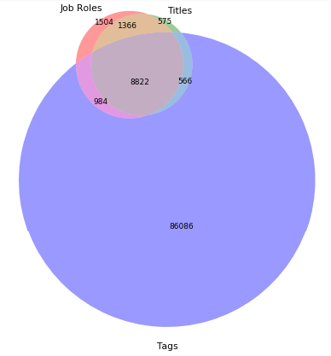
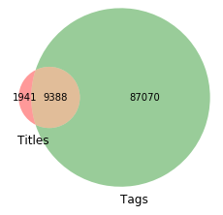
RecSys Challenge Exploratory Analisys Terms Analysis & Topic Modelling (II)
Terms Analysis & Topic Modelling
Anlysis on terms volume and intersection
Will influence in corpus decisions
Job Roles
Titles
1504
1366
575
2488
10188
1141
2870
9086
86652
8822
566
Job Roles
984
Job Roles
Titles
Tags
86086
1941
9388
87070
Titles
Tags
Tags

Slide 9
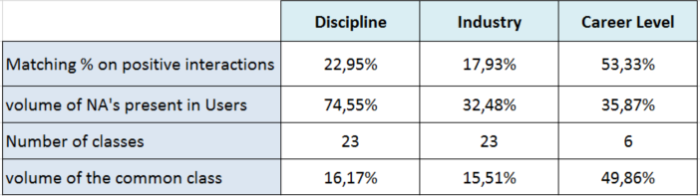

RecSys Challenge Feature Engineering Users NAs – Random Forest classifiers
User NAs
Random Forest classifiers
Enough correlation on users/items common features to loose lot of info for unfilled fields in user profile
There’re 12k different terms in Job Roles
→ Prohibitive to build a 12k-length feature vector
Alternative: dimensionality reduction of the “JobRole” vector
→ We select LDA as a valid alternative
Multiclass classifier (ignoring “JobRole”) v.s Multiclass classifier
(using only “JobRole” 150-topic LDA) performs similar.
→ but joining both sets of features we increase around 50%.
Heterogeneity of features and multiclass → SKLearn Random forest (100 estimators)
80% train / 20% test (over the user with non-NAs)
Use trained models on users with NAs to fill
We used all user features and the 150-topic LDA on JobRole
User features
150-LDA JobRoles
Discipline RF
Industry RF
Career RF

Slide 10


Content Based Recommender Solution approach
User Activity & Benefit Ranking
Content Based Recommender
Complements specific user’s interests (goes beyond patterns on user-item-interactions)
All (99,9%) targets items are “cold” → No clear way on CBF approach or CB based on users
But 68% users are non-cold (they have interacted with items in the past) → Opportunity to CB approach on items
Agg. positive interactions
(transaction user-item)
Interactions
Weights
300 LDA Item topic modeling
Similarity matrix
(cosine distance)
Similar items for each user
User
Weights
Top 100 Users
for Each Item
(when exists)
USER
ITEM
INT.
WEIGHT
WEIGHT
USER
ITEM
INT.
WEIGHT
WEIGHT
USER
ITEM
INT.
WEIGHT
WEIGHT
U
U
U
USER
ITEM
INT.
WEIGHT
WEIGHT
ITEM
. . .
. . .
. . .
. . .
. . .
. . .
. . .
. . .
ITEM1
USER N
ITEM
INT.
WEIGHT
300 topic frequency
USER N
ITEM2
WEIGHT
…………...
. . .
. . .
. . .
. . .
ITEM3
. . .
. . .
ITEM2
USER N
ITEM4
. . .
ITEM
U
U
U
USER
ITEM
INT.
WEIGHT
WEIGHT
Recsys Score for user-item transaction
Decay Rate score for last transaction activity
Global user benefit rank
User last activity rank

Slide 11
Interaction Based Classifier Recommender Solution approaches
Interactions Based Classifier/Regression
Interactions Based Classifier/Regression
Recommendation based on classifying every potential target item interaction with target user
Several approaches:
One class for every potential pair [item,user] interaction: only-click, bookmarked-replied, only-deleted, recruiter-interested
Binary classification for every potential pair [item,user] interaction : positive or negative
For each pair (user_i, item_j)
User_id | Item_id | Features_user | Features_item | Interaction_type | at
1 | 100 | … | … | 3 | 1/1/2017
1 | 101 | … | … | 4 | 1/1/2017
2 | 100 | … | … | 1 | 1/1/2017
2 | 100 | … | … | 5 | 2/1/2017
Users
Items
Pros:
Simple
Intuitive
Similar to baseline
Pros:
Simple
Intuitive
Similar to baseline
Cons:
Only one interaction used at a time
“Filters” needed to avoid cartesian product
Seems to capture only interaction patterns
Random Forest
Cons:
Only one interaction used at a time
“Filters” needed to avoid cartesian product
Seems to capture only interaction patterns

Slide 12
Interaction Based Regressor Recommender Solution approaches
Interactions Based Classifier/Regression
Interactions Based Classifier/Regression
Recommendation based on aggregating [item,user] interactions as a “transaction” an assign Recsys Score
For each pair (user_i, item_j)
User_id | Item_id | Features_user | Features_item | Interaction_type | at
1 | 100 | … | … | 3 | 1/1/2017
1 | 101 | … | … | 4 | 1/1/2017
2 | 100 | … | … | 1 | 1/1/2017
2 | 100 | … | … | 5 | 2/1/2017
Users
Items
User_id | Item_id | Features user | Features item | 0 | 1 | 2 | 3 | 4 | 5 | label
1 | 100 |  |  | 0 | 0 | 0 | 1 | 0 | 0 | +5
1 | 101 | … | … | 0 | 0 | 0 | 0 | 1 | 0 | -10
2 | 100 | … | … | 0 | 1 | 0 | 0 | 0 | 5 | +21
Random Forest
XGB Boosted Tree Regressor
Pros:
Aligned with Score function
Cons:
Same as previous

Slide 13
Ensemble Solution approach
Ensemble
%-based
21041
Different approaches capture different patterns
→ Joining 2 solutions reach 76,01% of potential
XGB Regressor focus more on user-item-interactions patterns
CB seems to complement with more specific user interests
Most single solutions leave out job items or failed to reach the 100 limit
Empirical & Recsys score formula promotes to fill the 100 user allocations
More solutions can be optionally used to full coverage of items & 100 user per items
Ensemble
%-based
13438
14227
Interactions Based Classifier/Regression
Content Based Recommender

Slide 14
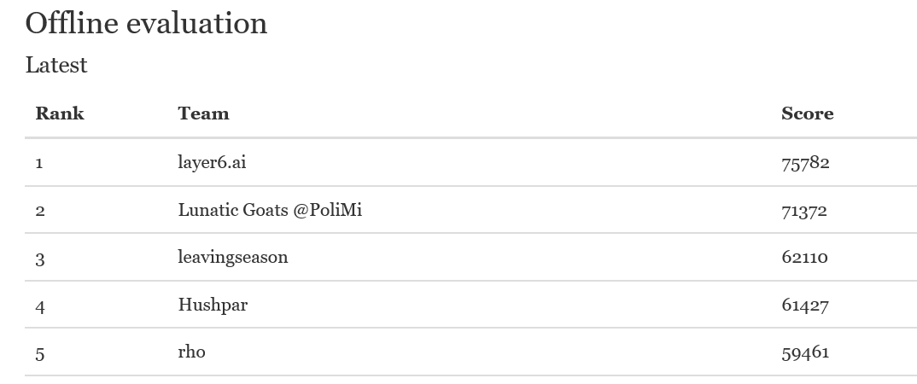
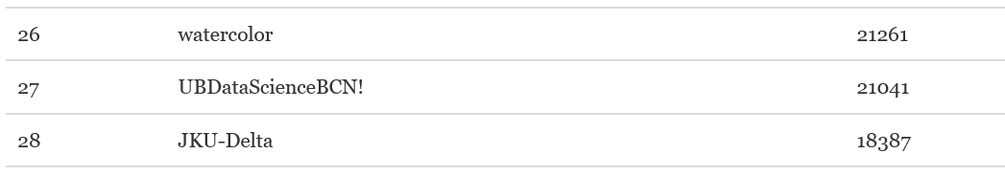
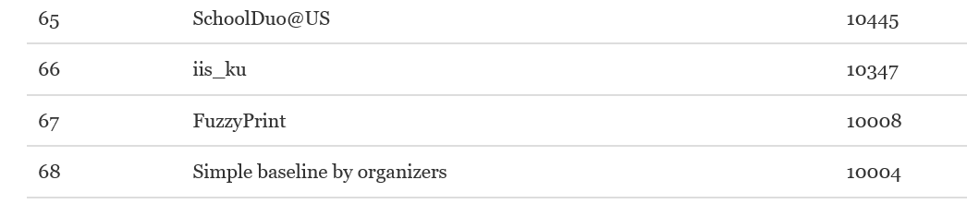
Results Test history & Classification
Solution | Score
Naive top-50 matching users | 1.287
Recsys baseline (XGB positive/negative/ no 0’s) | 10.004
Classifier RF positive/negative no-0’s | 11.401
XGB Regressor Recsys Score no-0’s | 12.113
XGB Regressor Recsys Score with 0’s | 13.438
CB Recommeder 150-LDA + weights | 11.816
CB Recommender 300-LDA + Last activity | 14.227
Ensemble 55% CB + 45% XGB Regressor | 21.041

Slide 15
Conclusions and Next steps
Ensemble
%-based
Conclusions |  | Successful use of several techniques from class: regression, classifiers, visualization, CB recommender, exploratory analysis, terms corpus, … Face real problem challenge & volume of data & poor information (assumptions) Different approaches pay off Difficulty to explain why some solutions are better than others Recsys challenge was hard as hidden test set seems extremely sparse (Best solution would be only reaching at least 5% of matching We achieved significant results but we humbly realize there’s room to improve |  | Next steps |  | Not all analysis insights developed into features No extensive analysis on impressions No analysis on “internal” engine of Recsys (good recommendation does not pay off if Recsys never shows the item) Deeper analysis on outlier users (filter out strange behavior) Time Series Analysis for predict user future activity Alternative approaches on topic modelling (LDA and gensim only explored)

Slide 16

Q & A

